Slide 1
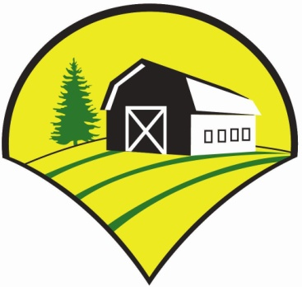
Growing Garlic
Jason Hovell
Tamarack Garlic Farm
www.TamarackGarlicFarm.com
Trempealeau, WI
Eau Claire Garden Club & Master Gardeners
Thursday, September 17th 2020
7:00pm

Slide 2
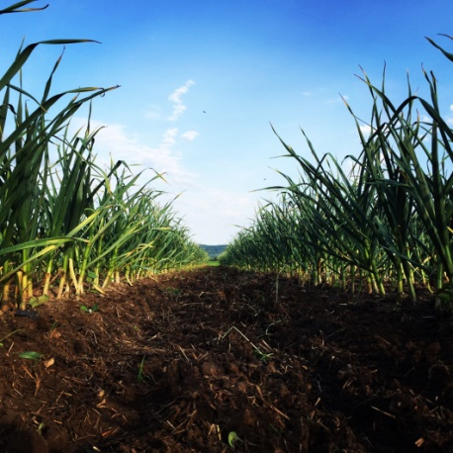
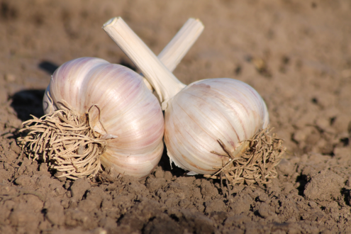
Some House Keeping Items-
We have a big crowd tonight! Please mute your microphones…
I am not here to sell you anything!
I’m not a garlic expert, I just grow a lot of garlic…
Tonight’s Presentation will be available to reference…
Questions- please type your questions using the “chat”. If they don’t get addressed immediately, we will get to them at the end!

Slide 3
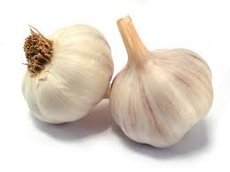
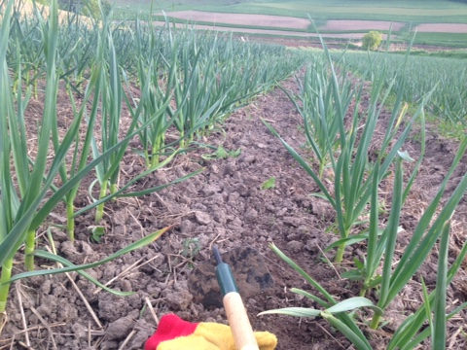
Goals of Presentation:
Introduction & Background of Tamarack Garlic Farm
Garlic Classification Review
Why Grow Garlic?
How to Grow Garlic!
Garlic Disease Prevention

Slide 4
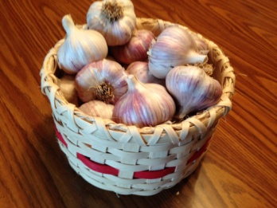
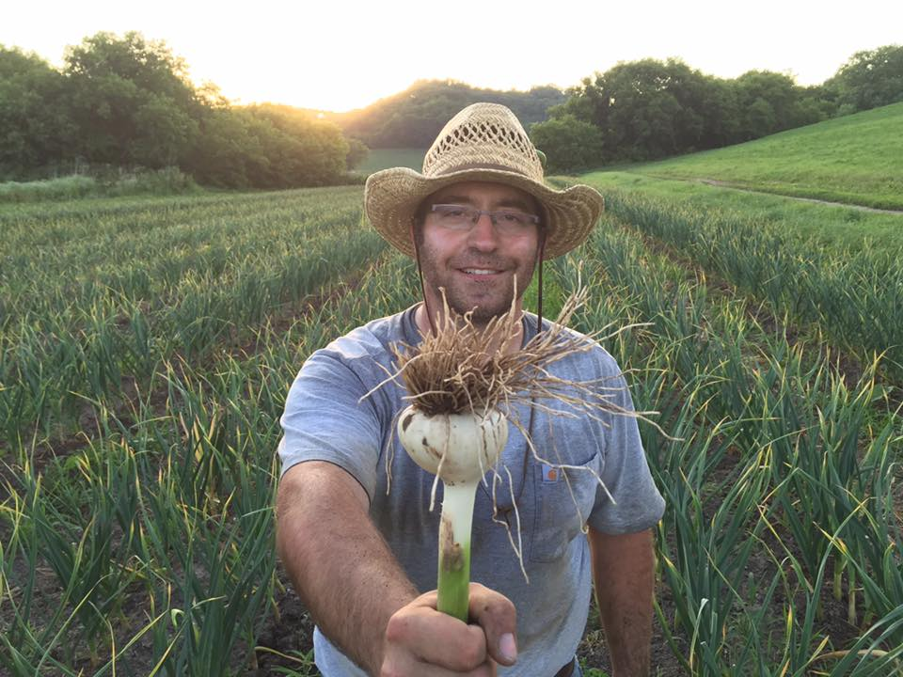
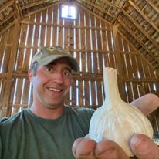
About Me…
Jason Hovell
Agricultural Education/FFA Advisor- 16 Years
Teach College Level Plant & Soil Science classes- Western Technical College.
UW-River Falls- Agricultural Education
Hobbies/Interests:
School Vineyard & Orchard, School Greenhouse, Aquaculture, Restore Tractors, Trempealeau County Fair Livestock Superintendent, Centerville Curling Club, hunting, fishing, kayaking, & amateur gardener…

Slide 5
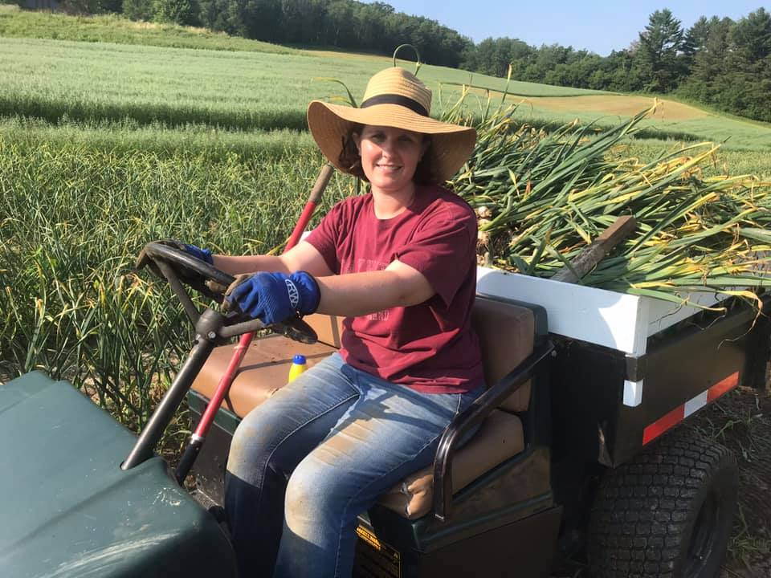
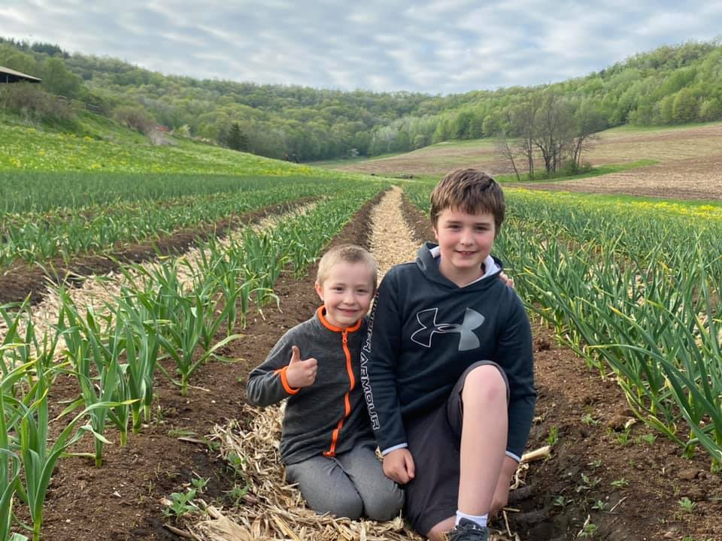
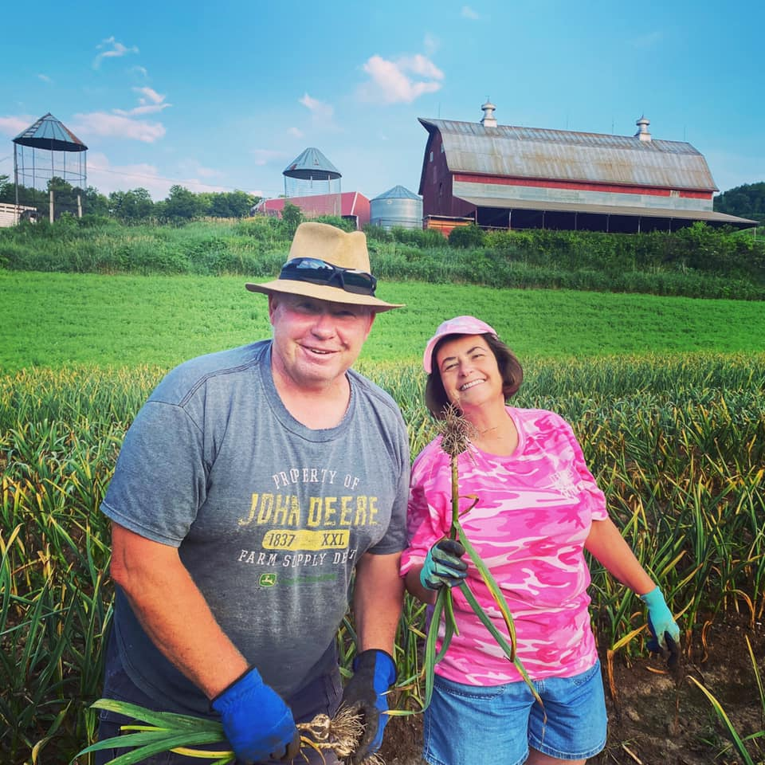
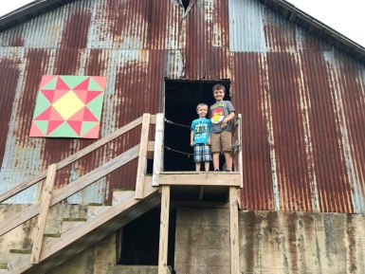
About Our Family…
Wife: Molly
Tucker (7) & Conner (11)
Parents: Leonard & Vickie

Slide 6
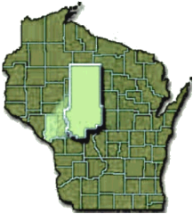
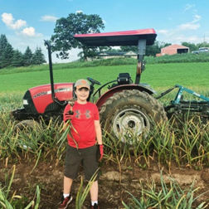
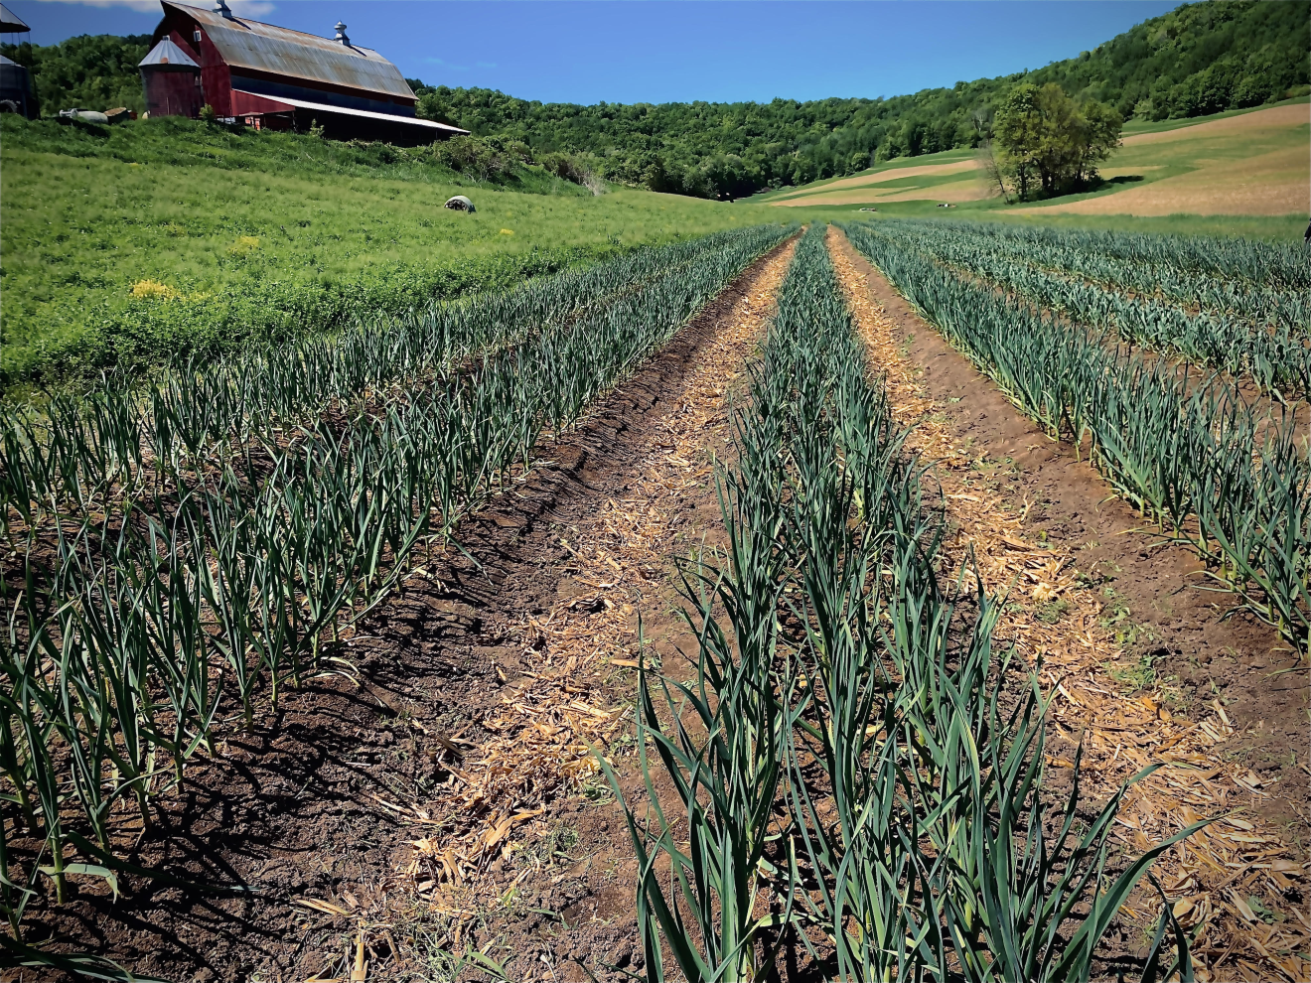
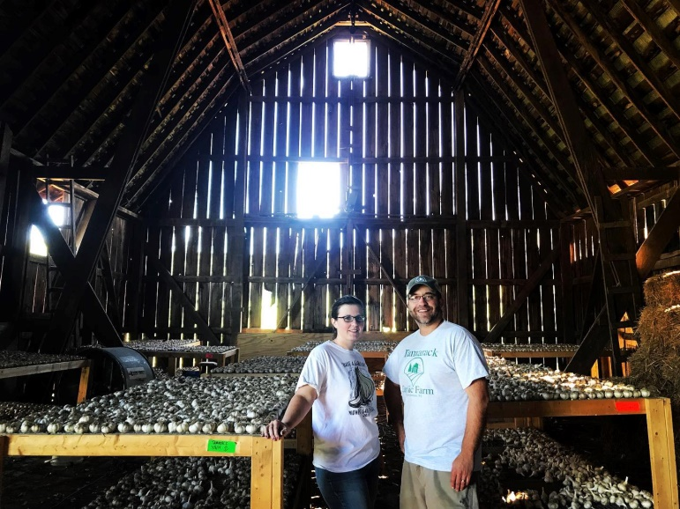
About the “Farm”… (Name, Size Scope…)

Slide 7
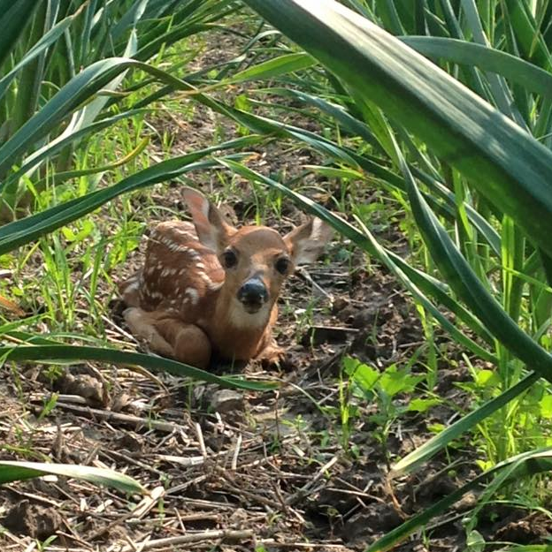
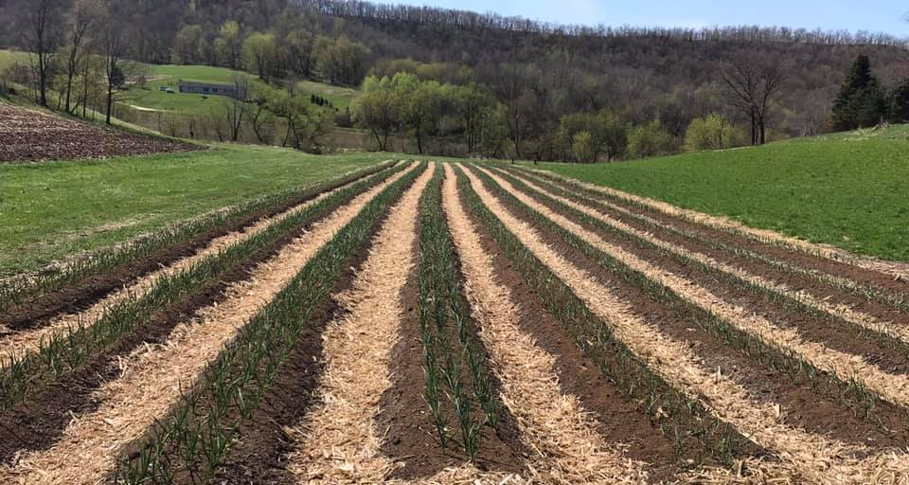
Size & Scope:
This past year we raised 9 varieties of garlic on 0.75 acres
~ 24,000 garlic plants (~40,000 in 2017).
Plant early/mid Oct. & Harvest mid-July (99% + germination)

Slide 8
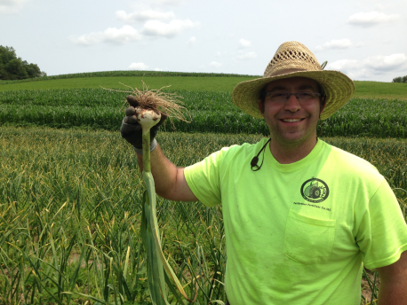
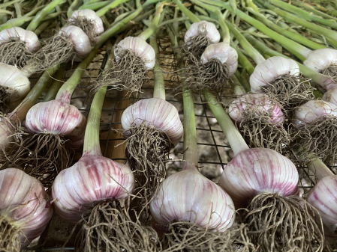
Garlic Classification:
All true garlics under the species Allium Sativum.
Two subspecies:
Hardneck (Ophioscorodon)
Softneck- (Sativum)
The hard-necked garlics were the original garlics and the soft-necked ones were developed or cultivated over the centuries by growers from the original hard-necks through a process of selection.
-Bob Anderson, Gourmet Garlic Gardens

Slide 9
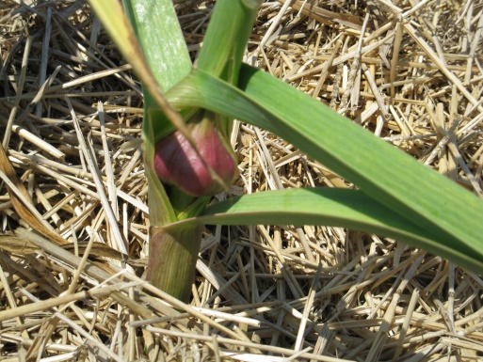
Garlic Classification:
Latest research* shows ten fairly distinct varietal groups of garlic have evolved;
5 very different hardneck sub-species
Porcelain, Purple Stripe, Marbled Purple Stripe,
Glazed Purple Stripe, and Rocambole;
3 sub-species of “weakly bolting” hardnecks that often produce softnecks –
Creole, Asiatic and Turban.
Plus 2 distinct softneck varietal groups;
Artichoke and Silverskin.
* Dr. Gail Volk, USDA & Dr. Joachim Keller, the Institute of Plant Biology, Germany

Slide 10
So How Many Varieties?
There are over 600 known cultivated common-names of garlic in the world, although most of them may be selections of only a handful of basic types that have been grown widely and developed their own characteristics over the centuries as local growing conditions changed.
At Tamarack Garlic Farm: Experience growing ~20 varieties
Currently grow 9 Hardneck Varieties-
Chesnok Red, Persian Star, Georgian Fire, Great Northern White, German Xtra Hardy/White, Russian Red, Bogatyr & Tamarack Rocambole
Previously have grown German Red, Music, Asian Tempest, Siberian, Metechi, Italian Red, Majestic, Polish White Softneck & more…
This fall planting Pehoski & Purple Glazer for the first time!

Slide 11
Where’s you Garlic From?
All garlics come these ten basic groups or sub-varieties of hardnecks that evolved in Middle Asia.
Their individual characteristics have been altered over time by careful (or accidental) selection and changing growing conditions, such as soil fertility, rainfall, temperature, altitude, length and severity of winter, etc.
Asiatics varieties developed as they spread across Asia and Europe…
Turbans developed in the Far East, while the Creoles developed in Spain & southern France
Artichokes & Silverskins developed in Italy and elsewhere in Europe by selection.
Side Note- Reach out to Tayna Webster at RPAgarlic.com if you have any classification questions! She grows 107 varieties and is a living garlic encyclopedia!
-Bob Anderson

Slide 12
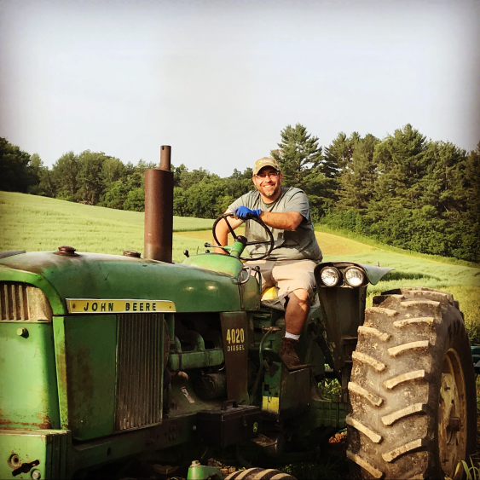
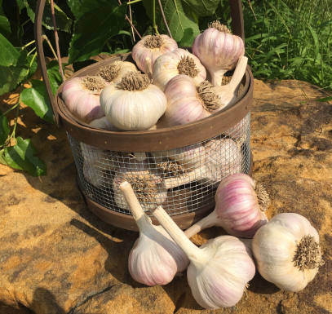
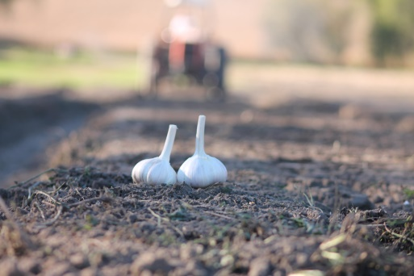
So…Why Do We Grow Garlic?
$$$...
Sustainability of farm for the future…
Growing season works well with the “day job”
Get children involved in agriculture & learn a work ethic…

Slide 13
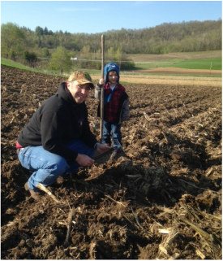
Step 1: Prepare to Prepare Soil -
Steps in Growing GREAT Garlic…
Soil Testing
“Don’t guess. Do a soil test.”
pH- shoot for 6.5-6.7 (6.3-7.2 should work!)
N- 120-140# N/Acre
P- 110-150 ppm P2O5
K- 150 ppm
Fe- 50 ppm-100ppm “recommended” min.
I like pushing it to 150-200 ppm!
Zn- 15-20 ppm rec. goal
(Low is ok…we will get to why!)
Mn-10-20 ppm goal
Cu- 5-10 ppm
B- 5-6 ppm
Ca-1000 ppm

Slide 14
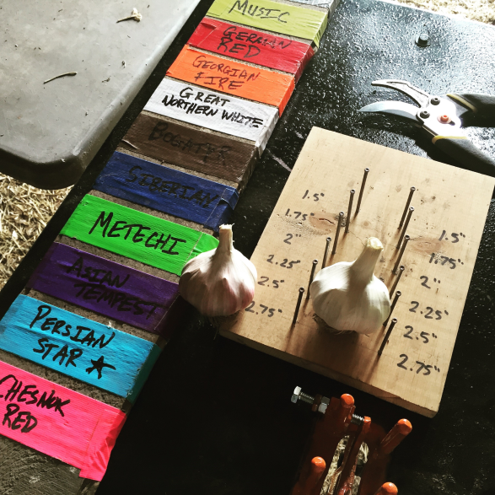
Element Tips:
Iron-
Having plentiful iron (Fe) available produces vivid colored bulbs. Good sales tool, as eye appeal helps sell the garlic. Everybody wants large colorful garlic!
Zinc-
A soil that is deficient in Zinc INCREASES the Iron uptake of many crops, including garlic...
Conversely, high Zn availability reduces Fe uptake (reducing bulb color).
Other Notables:
High levels of Phosphorus and Molybdenum also reduce iron intake (thus decreasing bulb color).
Calcium deficiency results in soft, watery cloves
Proper boron helps w/ cell structure & shelf life, but be careful when applying not to overdo this one!

Slide 15
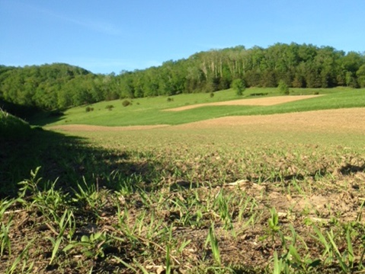
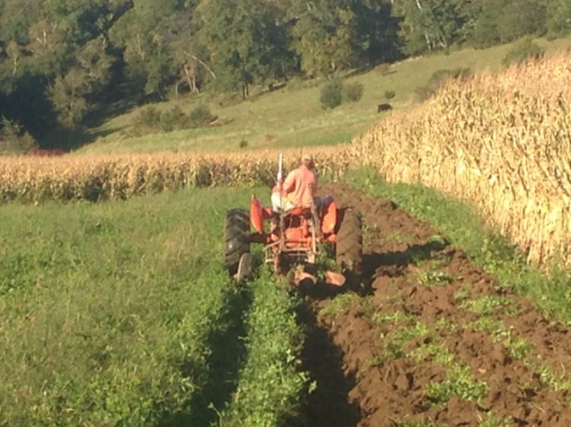
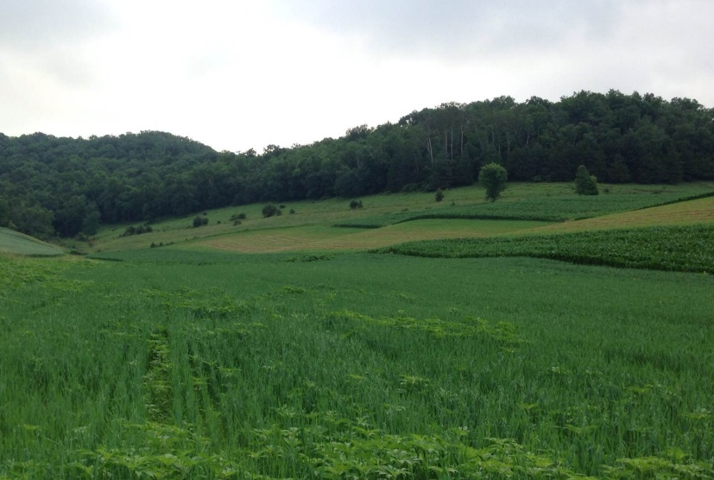
Step 2: Prepare Soil
4 Year Crop Rotation
We usually choose a cover crop of red clover/oats as we have “fields”…
Buckwheat, Mustards popular choices too…
Rotation of crop location important in the garden too!
Mid-July 2014

Slide 16
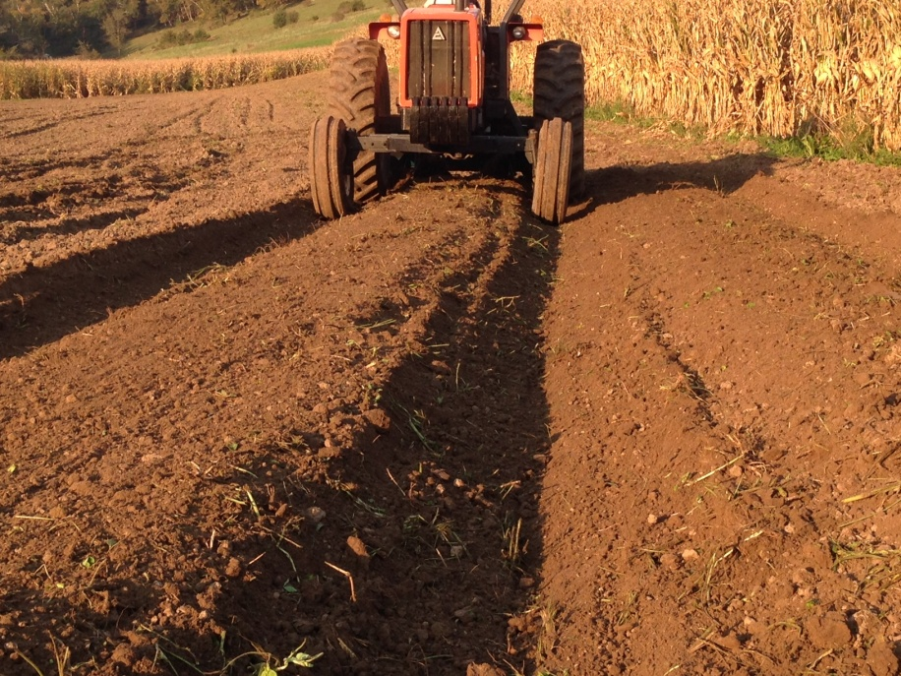
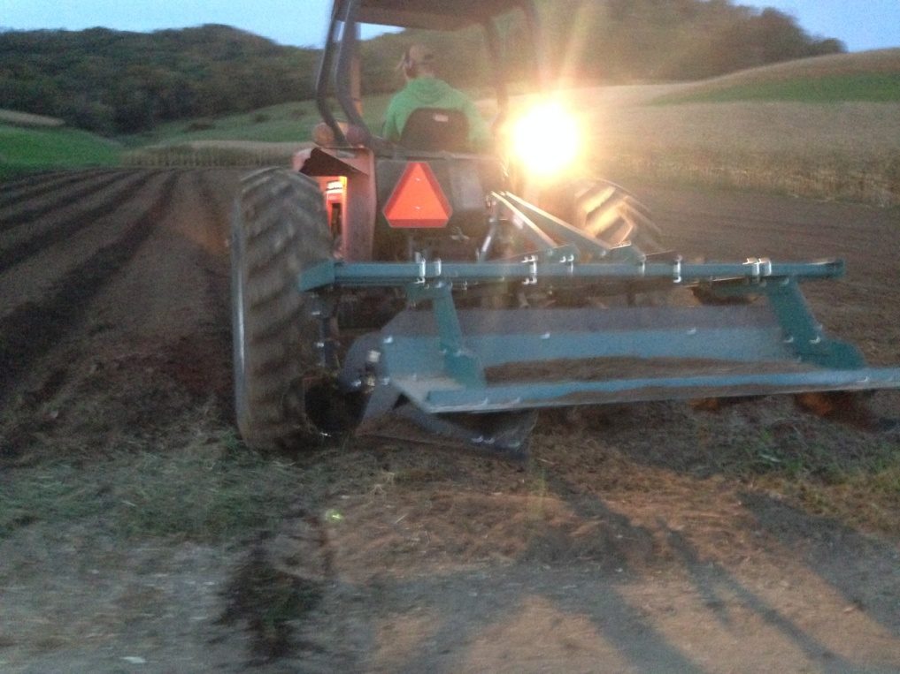
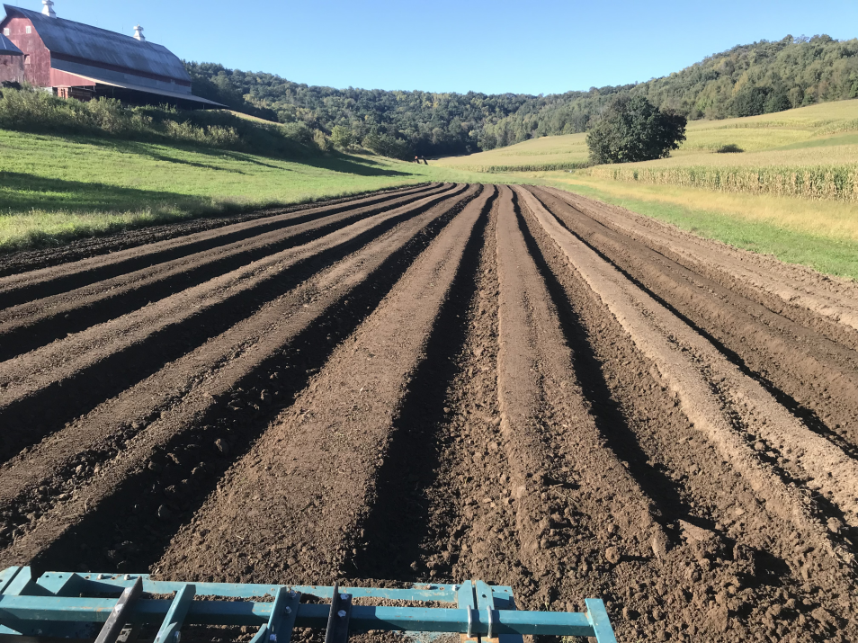
Prepare Beds…
Raised beds ~ 400’ long, 44” wide bed top, 7”-8” tall beds

Slide 17
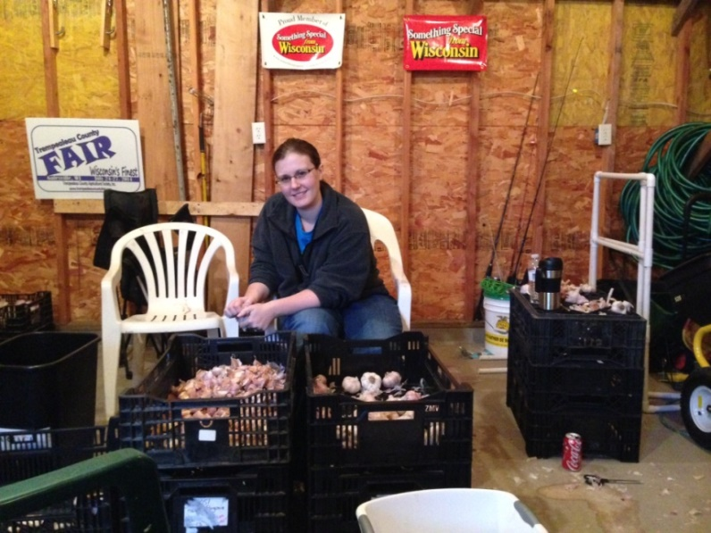
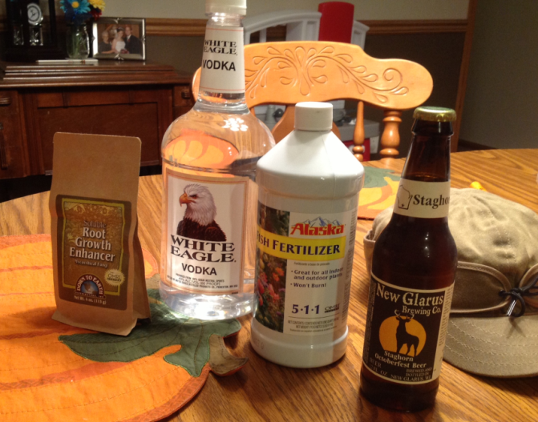
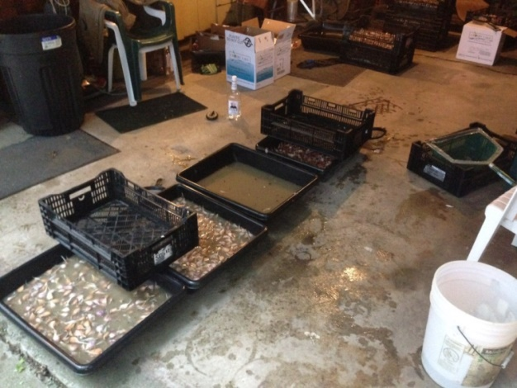
Step 3: Prepare cloves for Planting
Crack cloves apart within 24-48 hours of planting
Optional supplements that we use during planting…
We utilize a 15 min. Vodka soak to be proactive w/ possible lurking organisms, followed with a 60 minute
5-1-1 fish emulsion/ mycorrhizal fungi soak to get a jump start on good fall root growth before winter sets in!

Slide 18
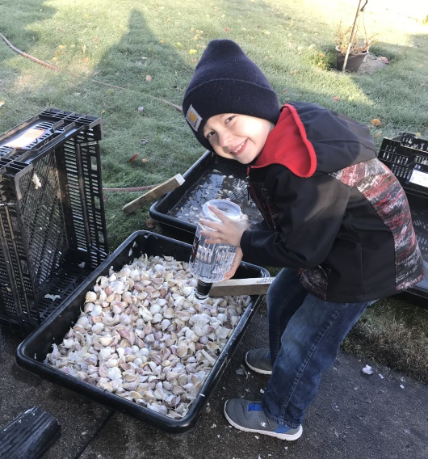
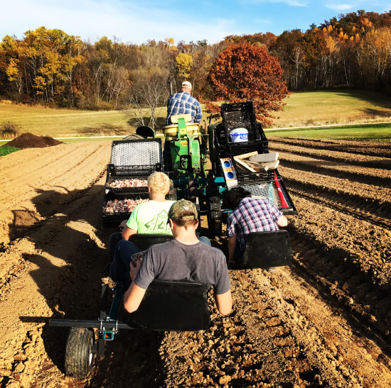
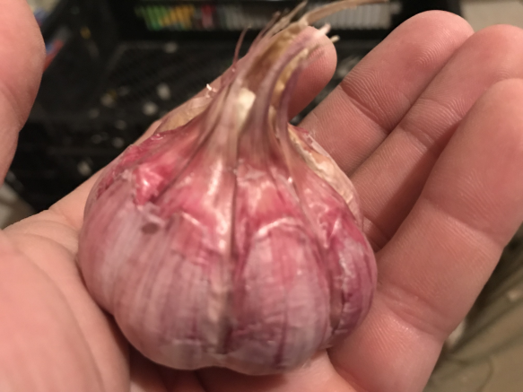
Planting Tips
Plant after the first frost!
Pointy-side up, root-end down
1.5”- 2” deep
6” spacing down the row, 8” between rows
Cover up for winter (Straw or leaves work great!)
Now it’s time for a glass of wine!

Slide 19
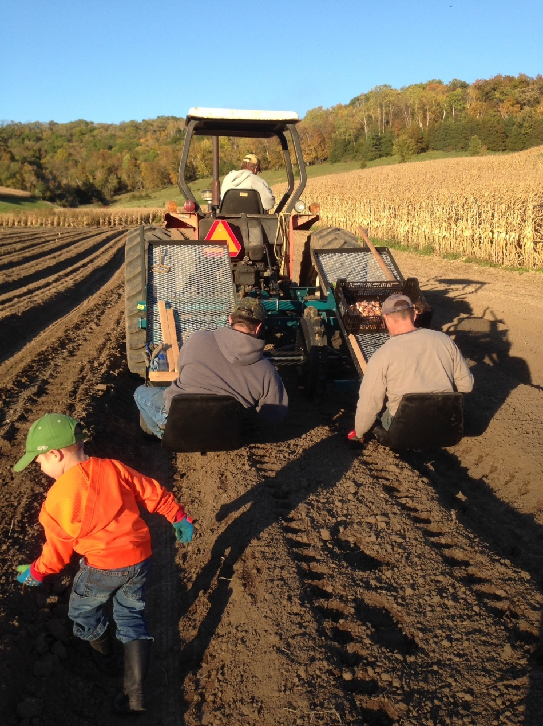
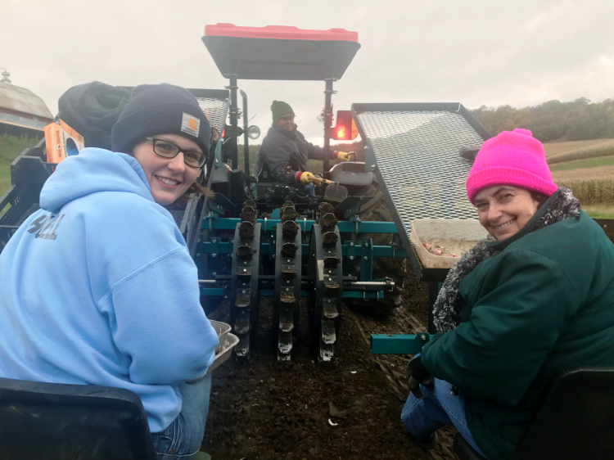
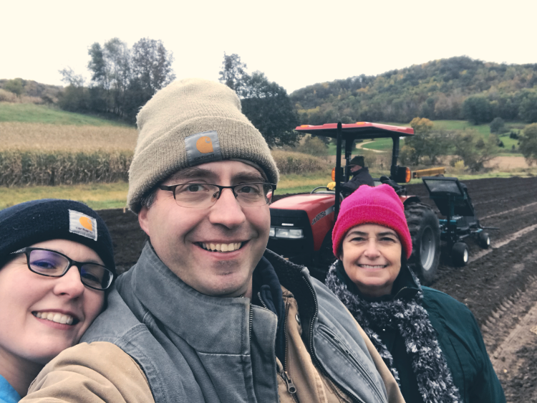
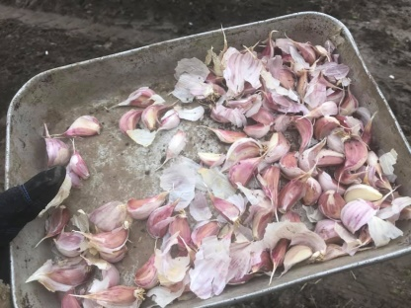

Slide 20
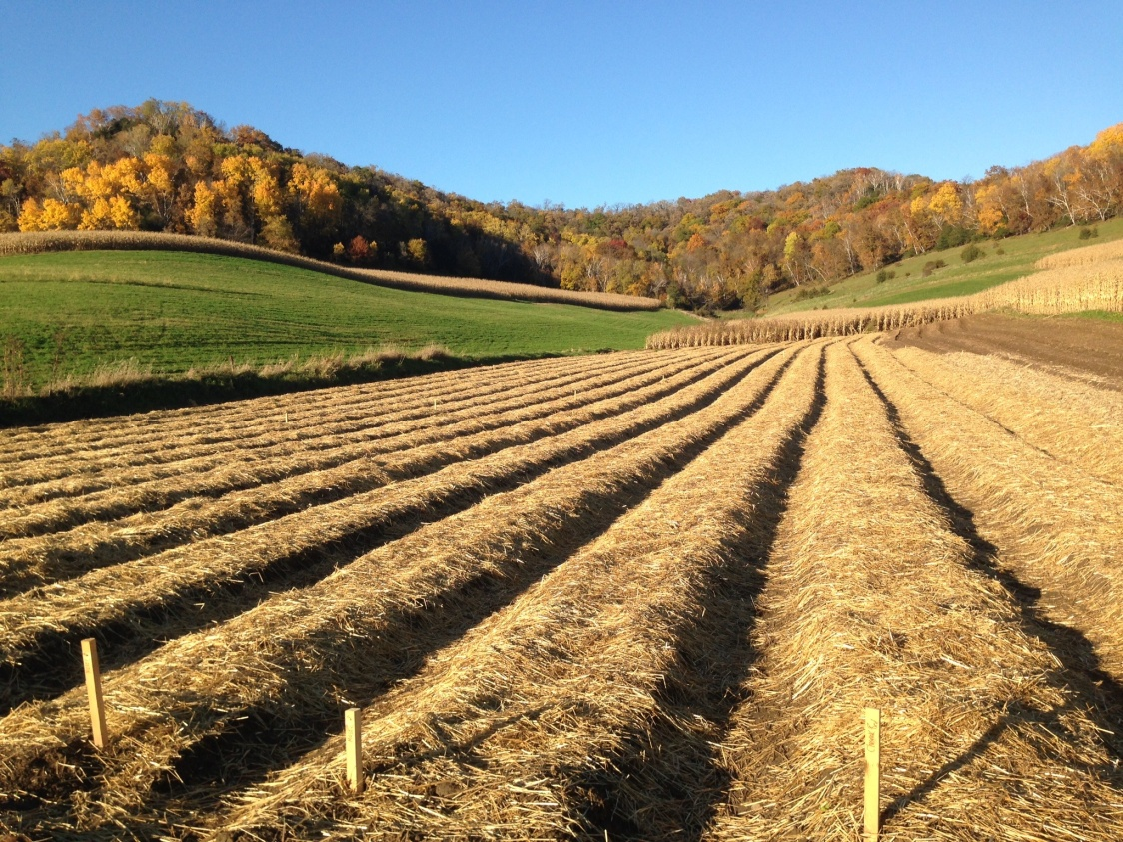
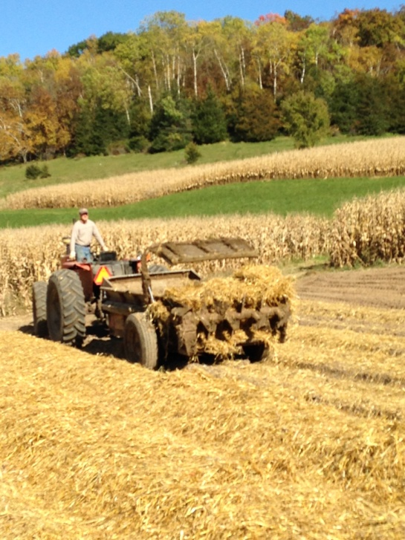
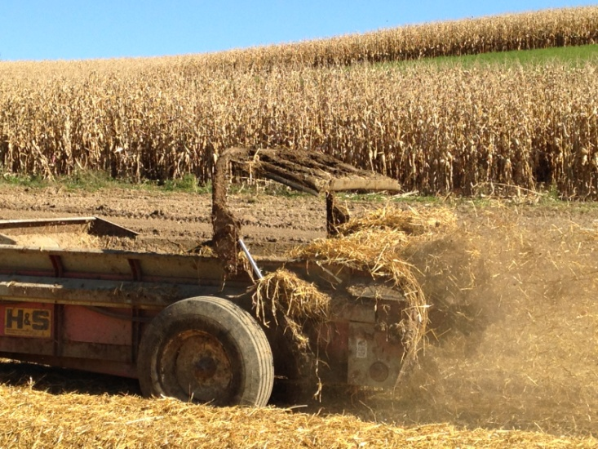
Oct. 25

Slide 21
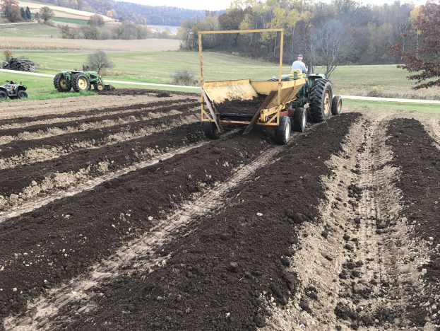
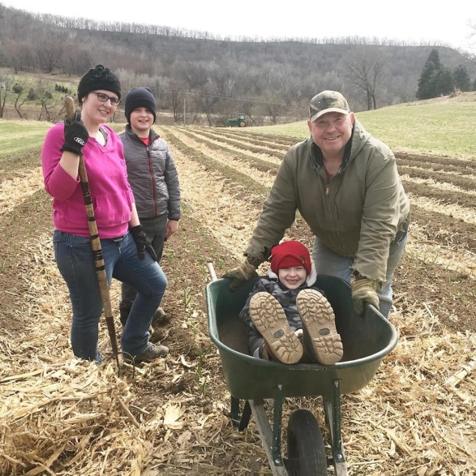
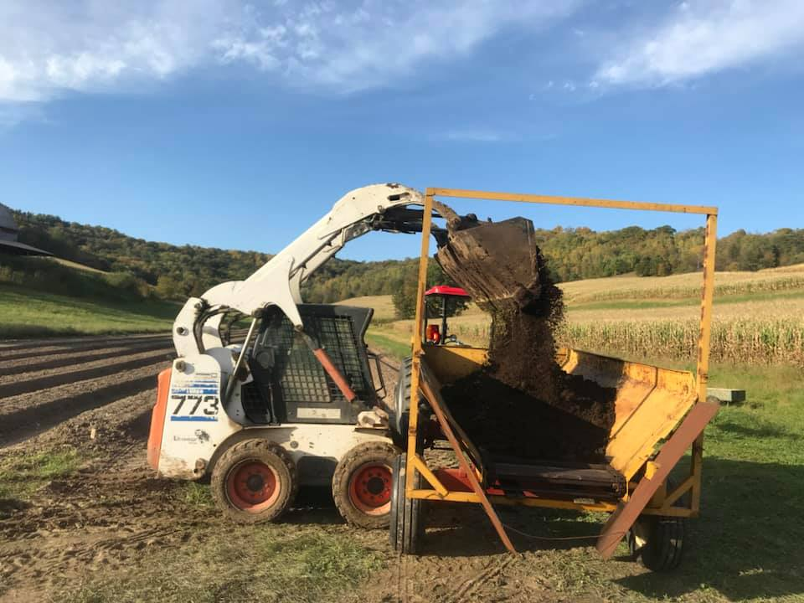
Still seeking for the cure for weeds!
Used Organic Dairy compost last 4 years instead of straw. Keeps weeds away until end of May.
Will experiment with plastic over beds this fall…
Experimented with flame weeding in 2017 but was too wet to be effective that spring.

Slide 22
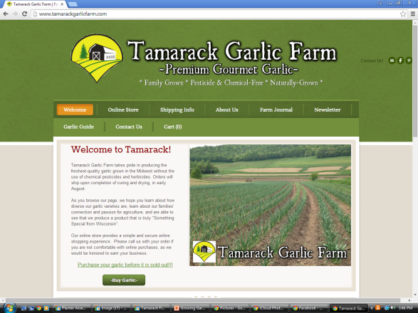
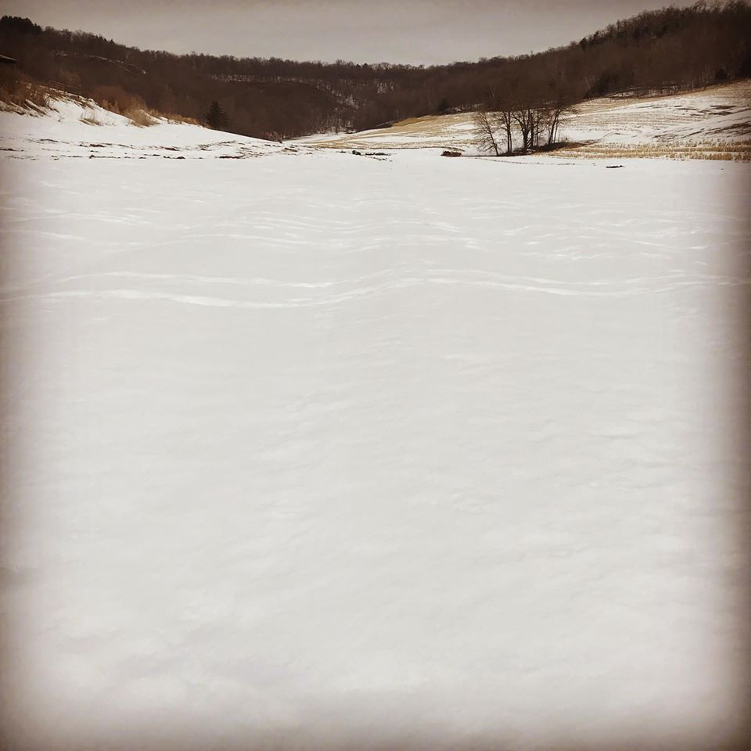
Then we wait…
Garlic growing is easy November –April, but we keep busy…

Slide 23
And then… ...Spring!
3/21/20
4/1/15
4/17/2015
3/29/20

Slide 24
Spring can be unpredictable…
Spring snow is fine for garlic!
(Grandpa called it “poor farmer’s nitrogen”
I’ve heard people corresponding the date in May with the Low temp threshold, for our climate, and think that holds pretty true- “ As long as it doesn’t get below 15 F on May 15th or below 20 on May 20th”, your hardneck garlic should be ok!
April 12, 2020
April 13, 2020

Slide 25
Cultivate, Hand Weed, Repeat-
5/25/15
6/7/15

Slide 26
Pick Garlic Scapes Mid-June
Flowering Structure of garlic plant.
1. Removing puts more energy into bulb formation.
2. Taste Great!
When to pick scapes?

Slide 27
Market for Scapes?

Slide 28
Harvest
This year we harvested July 7-12th
When to harvest…

Slide 29
Harvest with 4-5 green leaves remaining on plant

Slide 30
Old Curing Method (thru 2017): Hanging

Slide 31
Since 2018- Use Racks for Curing

Slide 32
Marketing-
10% - Sell at Farmers Market & Midwest Garlic Fest
75%- Sell online at our website, tamarackgarlicfarm.com
Sold to 49 of 50 states the last 2 years (Rhode Island must not like garlic breath!)
15%- Keep back for Replanting…

Slide 33
Packing Shed- Distribution

Slide 34
Diseases
Most garlic diseases are either soil- or seed-borne and usually can be controlled with proper rotation and planting disease-free seed.

Slide 35
What to watch for…
Garlic Stem Bloat Nematode
Invasion of the stem tissue occurs first, causing stunting, twisted, and pale leaves, followed by rotting of lower stem and bulb base.
Controlled by proper crop rotation with non-susceptible crops for four years, removal of infected plants, and planting disease-free seed.
Send samples to U of MN, UW, or Cornell!
Appear stunted, turn yellow, dry prematurely and are easily pulled from soil.

Slide 36
What to watch for…
Botrytis
Fungus attacks leaves following periods of warm, wet weather and bulbs in storage.
Symptoms include water-soaked stems, which is why the disease is often called "neckrot”, and in severe infections, the bulbs may rot.
Control this disease by promoting air movement through the field so that foliage does not remain wet. Rapid drying during harvest, followed by good aeration during storage, will also minimize the problem. Use planting stock free of the disease.
Botrytis bulb rot of garlic.

Slide 37
Garlic Diseases:
Yellowing leaves of garlic plant caused by white rot infection
White Rot
Most active when the temperature is cool, in northern climates it usually attacks in the spring.
Symptoms include premature yellowing and dying of older leaves, stunting, and leaf tipburn, followed by destruction of the root system, shoot dieback, and rotting of the bulb.
Control by rotating out of allium crops for many years (white rot has been know to persist in soil for ten years), destroying infected tissue, and planting disease-free seed stock.
Close up of white rot on base of garlic stem

Slide 38
What to watch for…
Fusarium
Plants may or may not show symptoms in the field or at harvest, but bulbs may subsequently rot in storage.
May show reduced emergence, yellowing and/or browning of leaves beginning at tips. Other symptoms include reduced bulb size, bulb decay, and brown, poorly developed root systems.
Control by avoid rotations with other Alliums.(onions, shallots, onions, leeks), store bulbs at cool temperatures and low humidity with good ventilation, and avoid storing damaged bulbs.
U of M photo

Slide 39
To Contact / Order :
“Our mission at Tamarack Garlic Farm is to produce and provide the best garlic in the Midwest, through using a combination of hard work and using innovative and sustainable agriculture practices. We pledge to do this without the use of pesticides and herbicides.”

Slide 40
Questions

